Slide 1
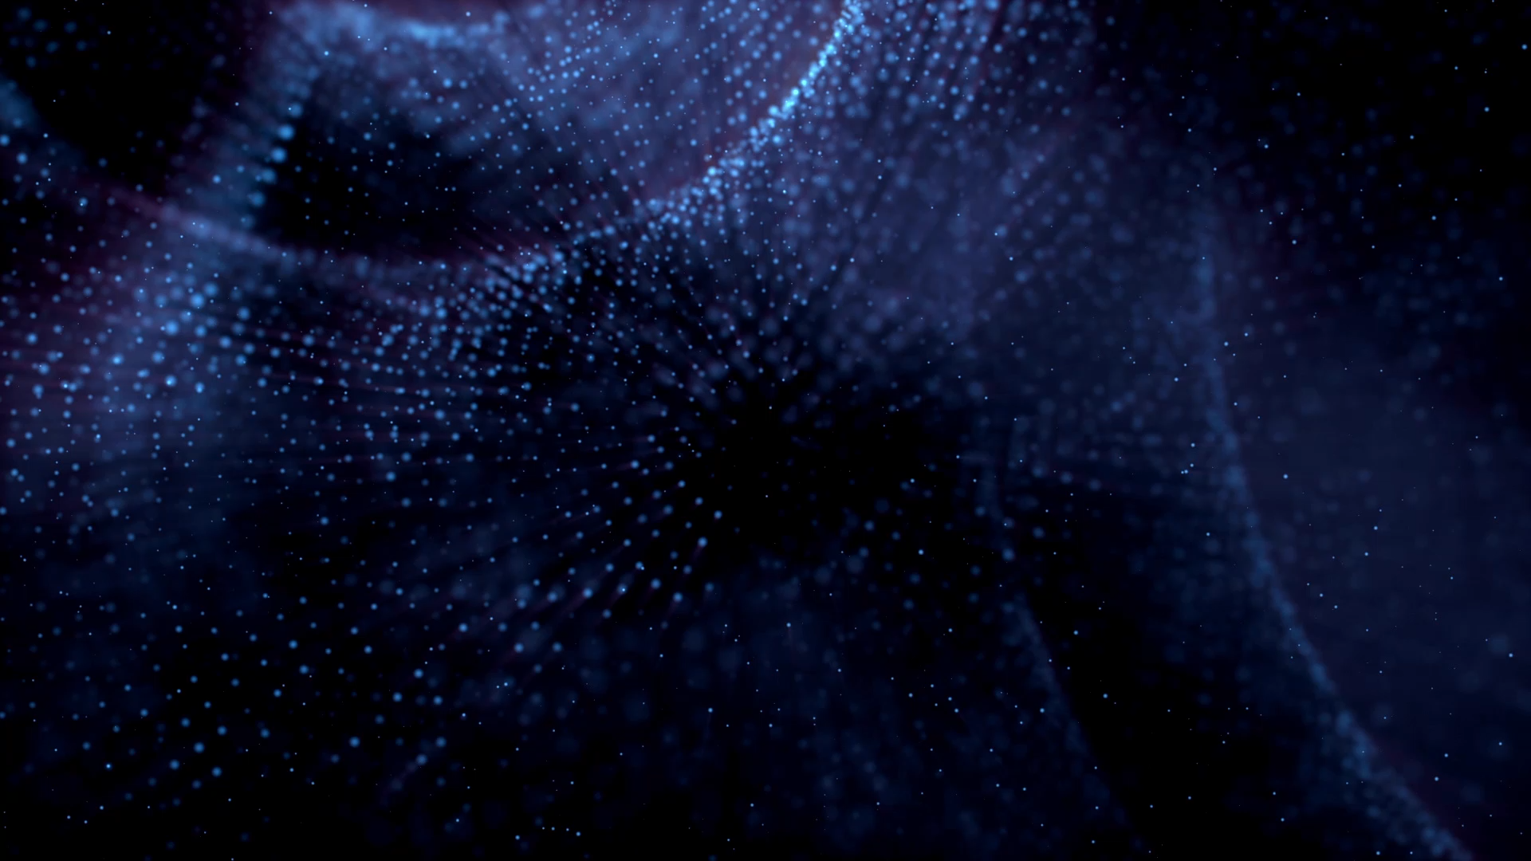

Vision and Cognitive systems Course Final Project
Hand detection and segmentation by implementing R-CNN and Meanshift
Prof. Lamberto Ballan
Physics of data
Asal Rangrasiasl - 2046832
03/03/2023

Slide 2

INTRODUCTION
AIM OF THE PROJECT
MATERIAL AND METHODS
DATASET
METHODOLOGY
RESULTS
CONCLUSION & QUESTIONS
CONTENTS

Slide 3



INTRODUCTION
Object detection is an important task in computer vision and has a wide range of applications. Hand detection is an important technology with many practical applications in various industries, including gaming, healthcare, education, entertainment
In this work, we propose a combined approach for hand detection and segmentation using Region-based Convolutional Neural Networks (RCNN) and Mean Shift Segmentation.
The pre-processing step involves applying bilateral Filter and erosion on the images to reduce noise. In addition, Mean Shift Segmentation is applied to segment the objects in the image.

Slide 4


AIM OF THE PROJECT
Proposed Method :
The proposed methods structure is to use the Ego-Hands dataset to train a Region-based Convolutional Neural Net- work (R-CNN) for hand detection
R-CNN:
Combine fine-tune a classification CNN with Selective Search, we’ll be able to build our R-CNN object detector.
Evaluate:
Training and Validation accuracy of R-CNN for classification (Hand, Non-hand), showing the outputs of different filters

Slide 5




MATERIAL AND METHODS
Understanding The Context
Retrieving The Data
Dataset Preparation
Building Models and Training
Evaluation of Models and Reporting
study about different methods for hand detection
The Ego- Hands dataset contains 48 Google Glass videos of complex, first-person interactions between two people.
Build an object detection dataset using Selective Search
Fine-tune a classification network ‘VGG16 ’ for R-CNN with pre-trained weights
Combining Mean Shift Segmentation
& R-CNN to detect hands in an image

Slide 6
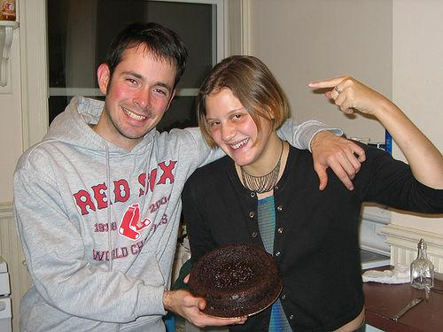
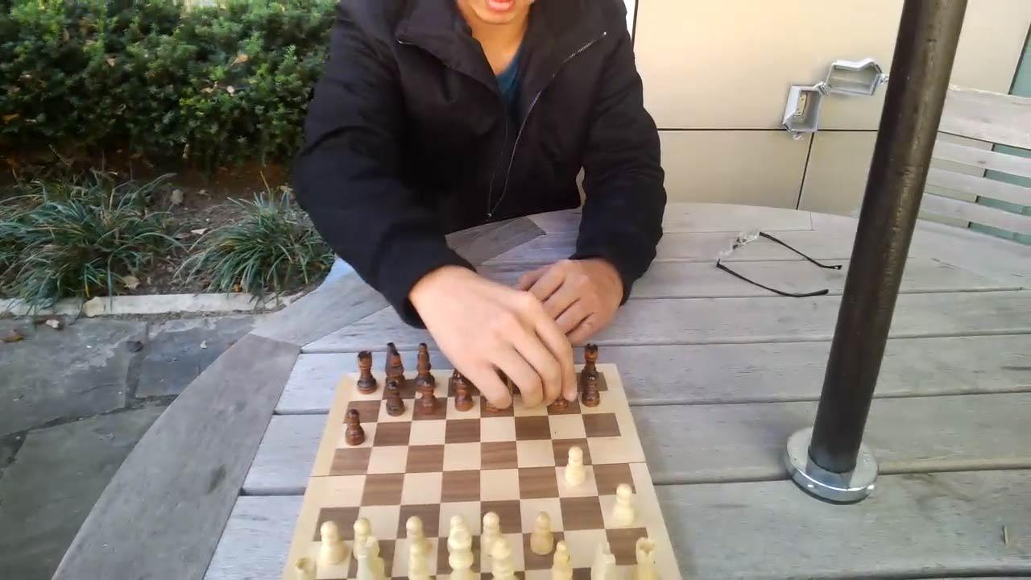
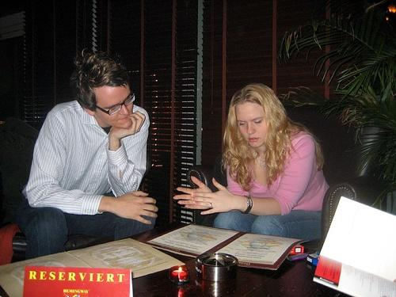
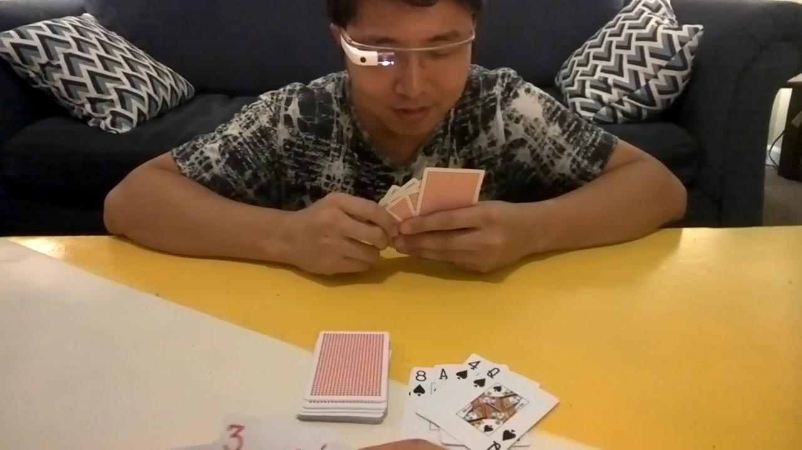
DATASET Prepration
EgoHands ( A dataset for Hands in Complex Egocentric Interactions )
The Ego- Hands dataset contains 48 Google Glass videos of complex( interactions between two people )
41 of the images are chosen from all kinds of hands
ground truth (XML files containing the coordinates of the hands in each image )
selective search algorithm is applied to each image
Examples of dataset

Slide 7
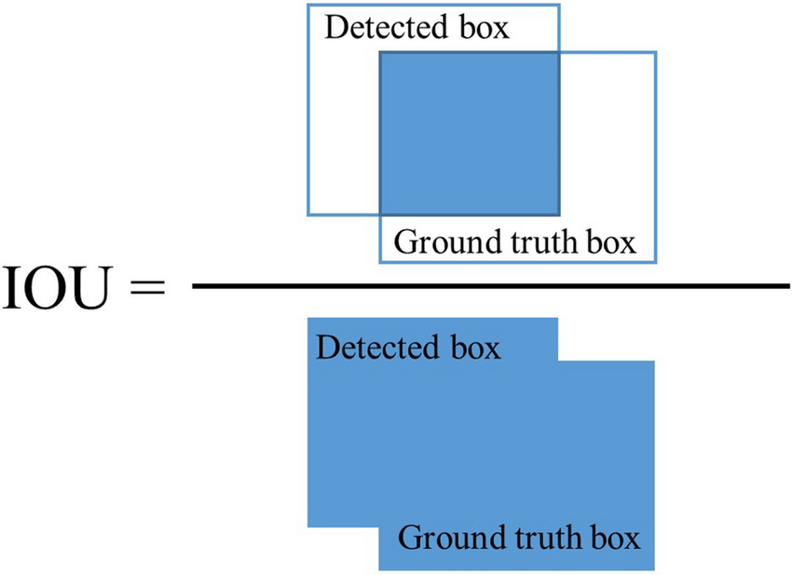
Object detection dataset builder
Build an object detection dataset using Selective Search
Input directory of images
Loop over all images in dataset
Load & parse bounding box
Run selective search on input images
Determine which bounding box overlap with ground truth (IoU)

Slide 8
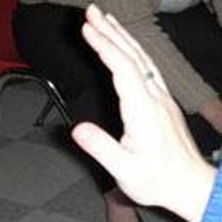
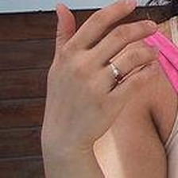
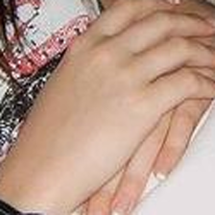
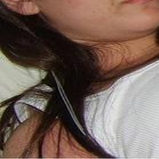
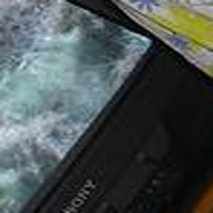
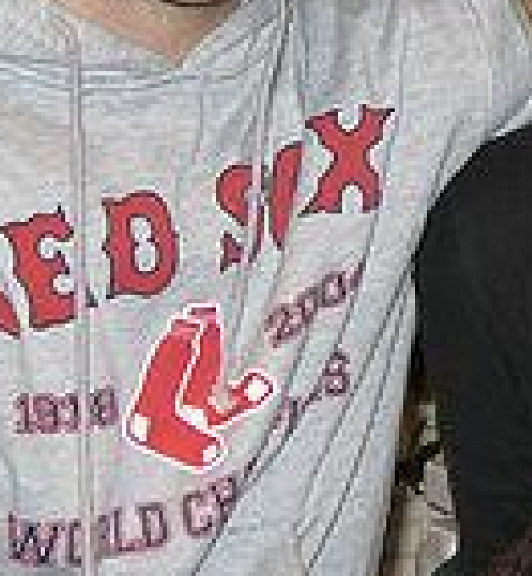
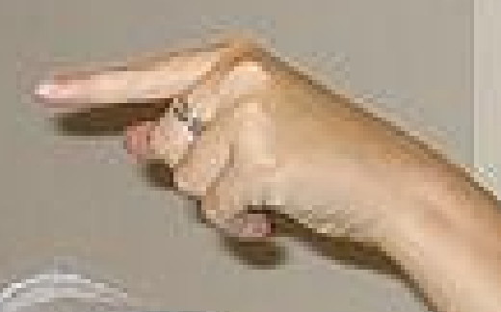
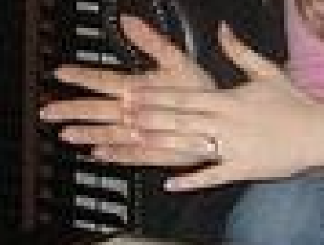
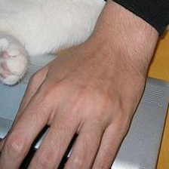
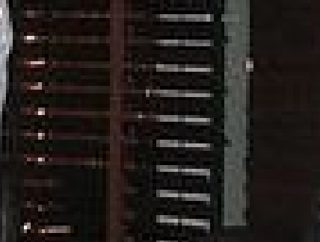
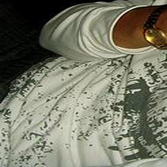

DATASET Prepration
Preparing our image dataset for object detection
IoU > 70 % : HAND
Number of samples = 441
INPUT_DIMS = (224, 224)
Not full Overlap and IoU < 5% : NON-HAND
Number of samples = 190
INPUT_DIMS = (224, 224)
HAND dataset
NON-HAND dataset

Slide 9
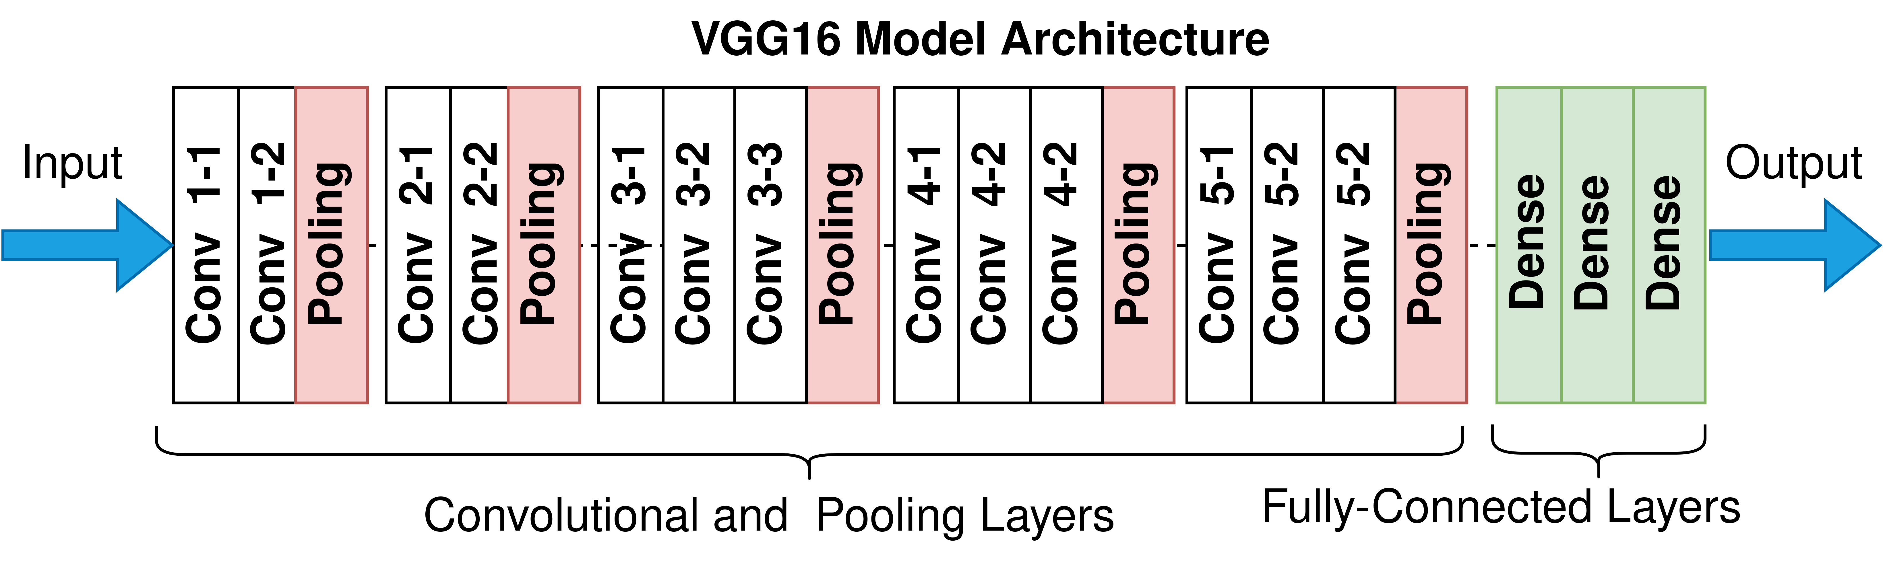
Training: Fine-tuning a network for object detection
With our dataset created via the previous section, we’re now ready to fine-tune a classification CNN to recognize both of these classes(hand, non-hand)
Data augmentation (rotation, width shift, height shift)
Splitting: 70% training, 30% testing
(Base-model)
VGG16
Dense=128
Activation= Relu
Dense= 2
Activation=sigmoid
Class 1
HAND
Class 2
NON-HAND

Slide 10
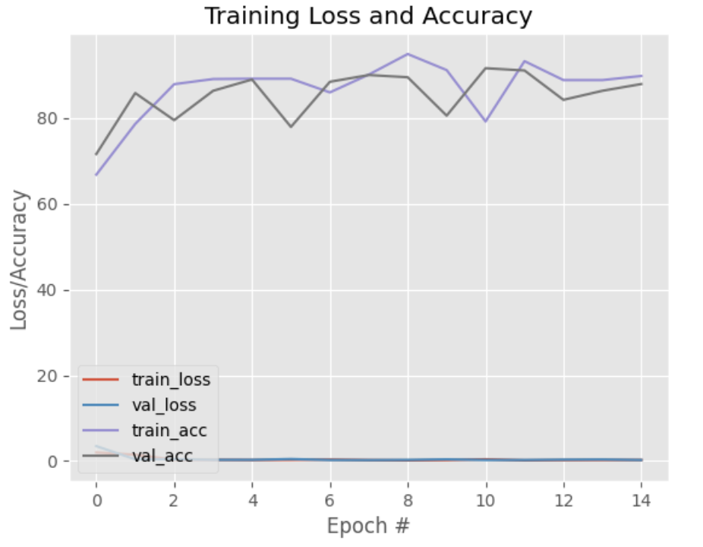
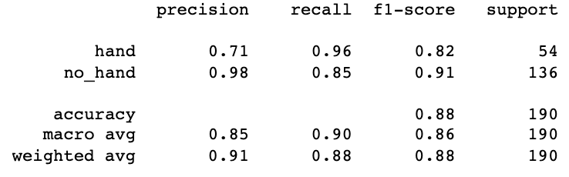
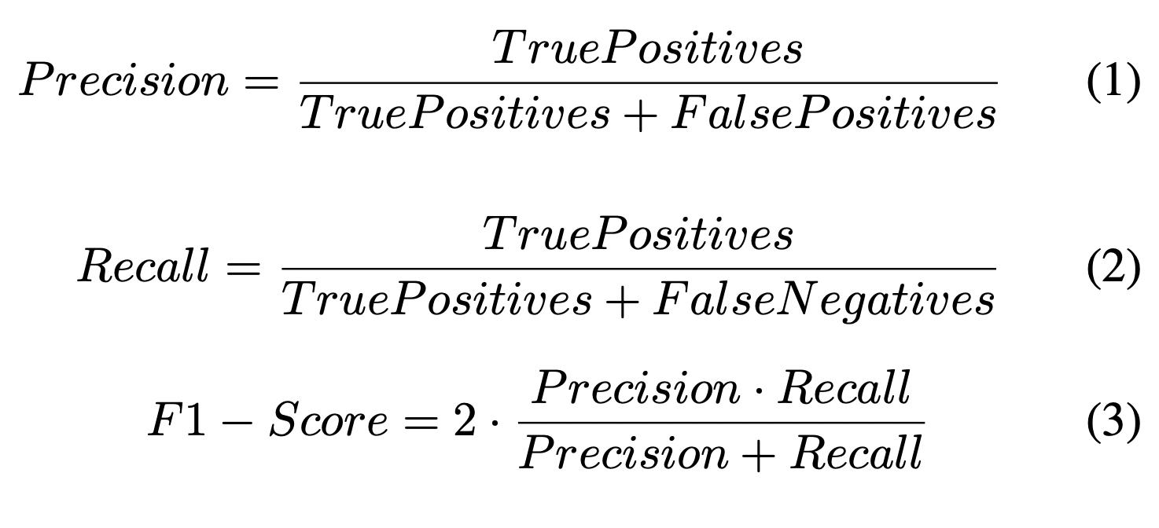
RESULTS (classification of HAND, NON-HAND)
Training & validation accuracy : In 11th epoch, our model achieved 93.23% and 91.05% train and test accuracy, respectively
Optimizer = RMSprop (learning rate =0.0006)
Batch size = 128
Epochs =15

Slide 11
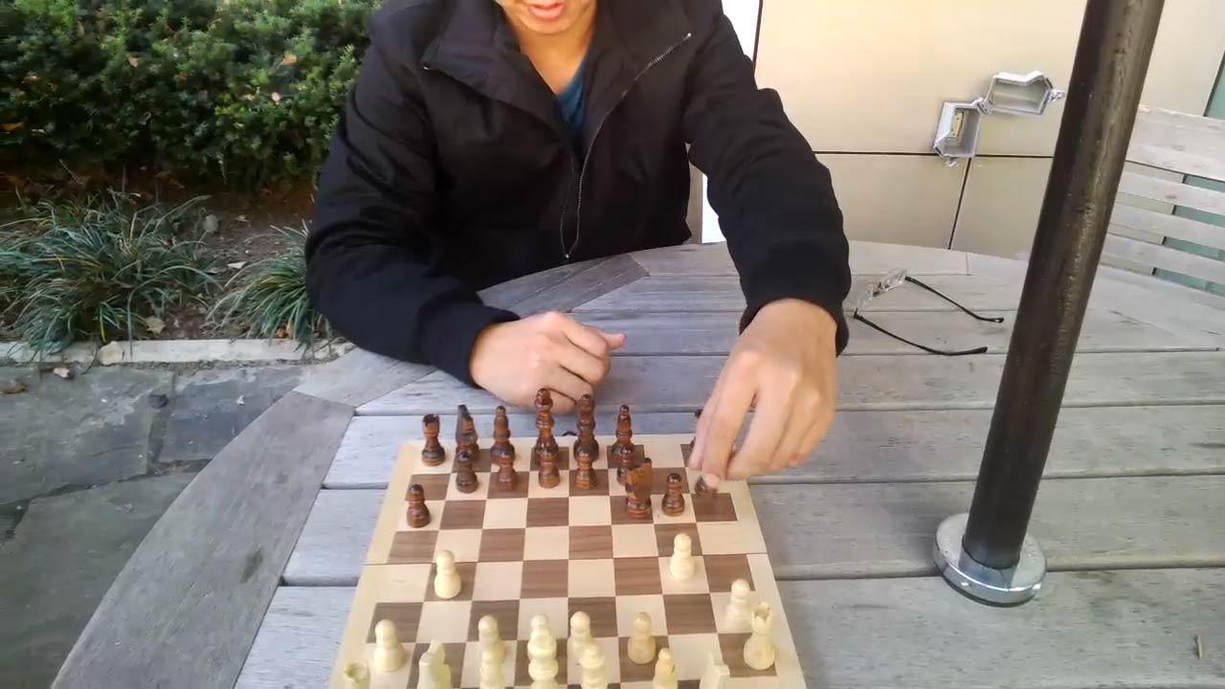
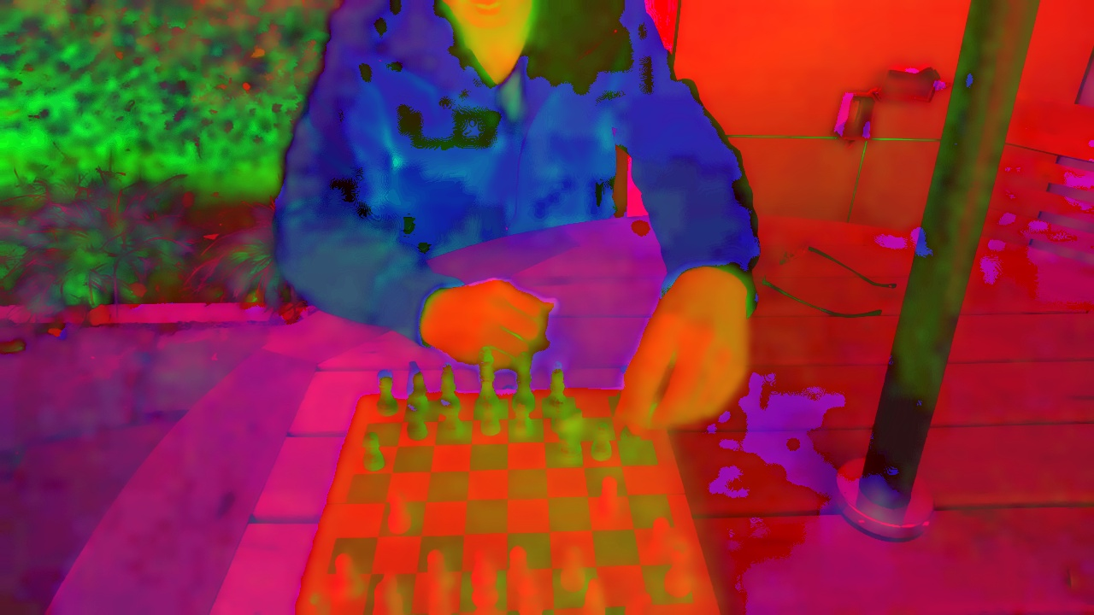
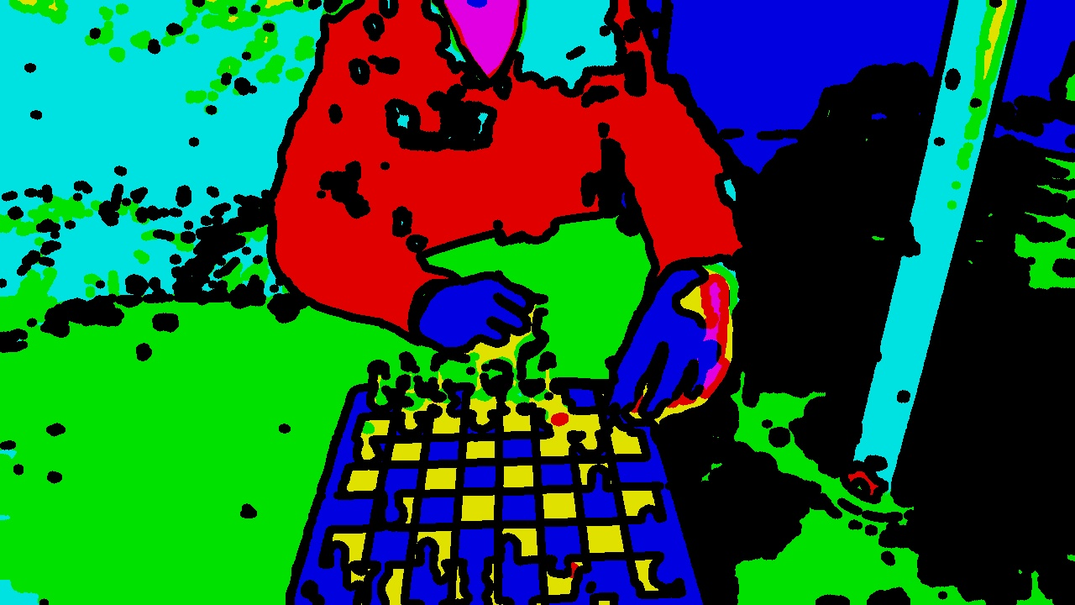
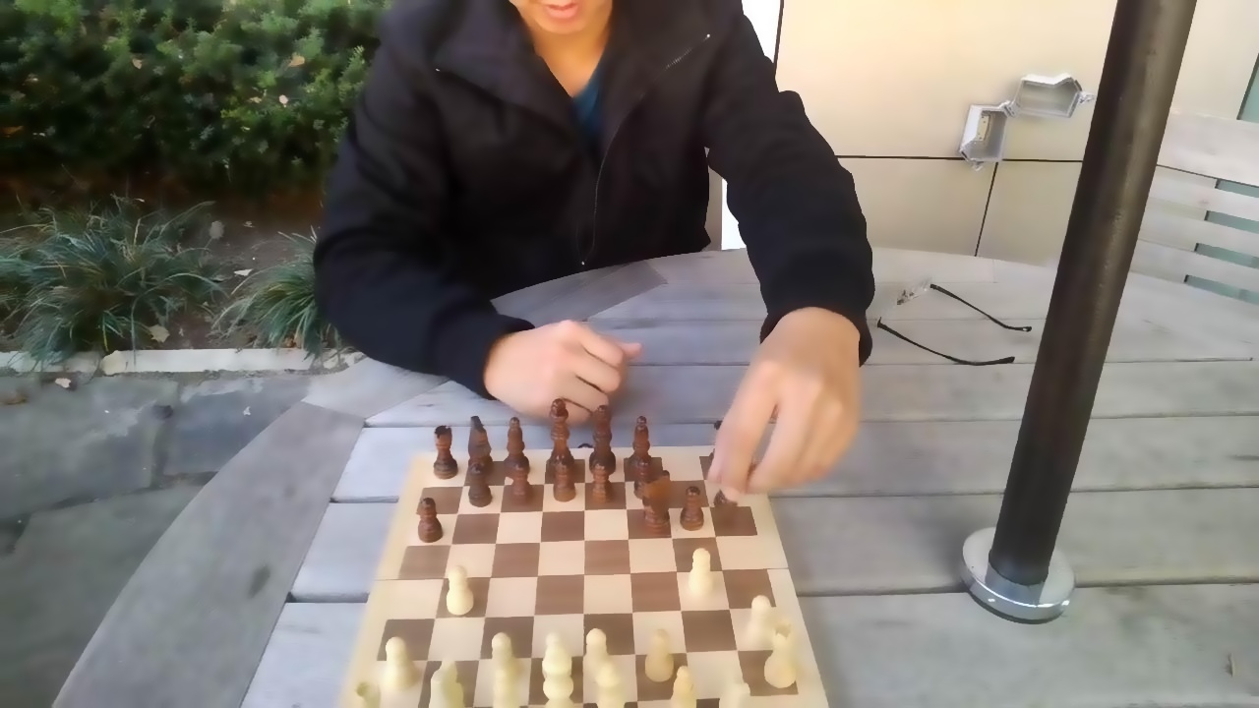
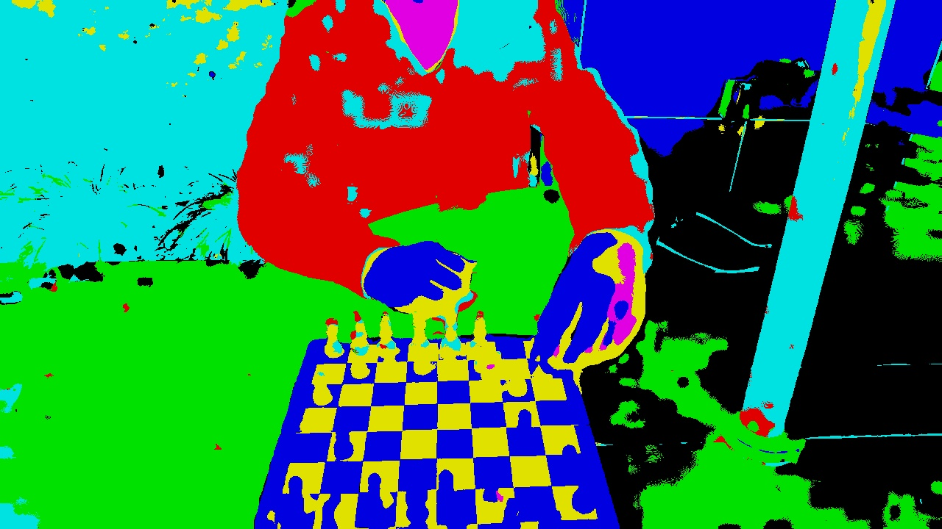
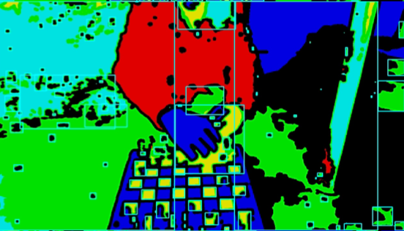
METHODOLOGY: Meanshift segmentation
Put our trained model to work to perform object detection inference on new images.
Input image
Bilateral
Mean shift
erosion
RGB to HSV
find Contours

Slide 12
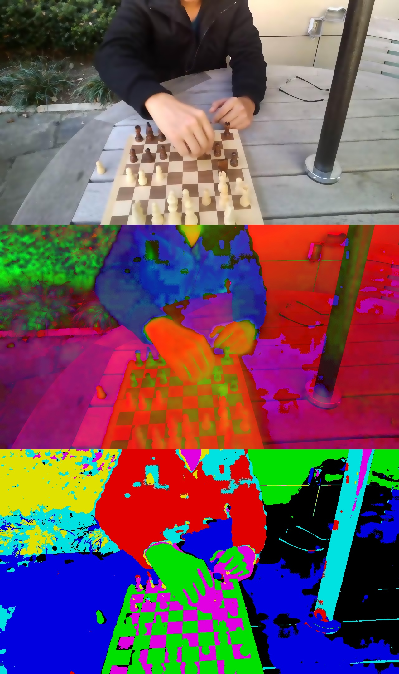

METHODOLOGY: Meanshift segmentation
Mean Shift is a non-parametric clustering algorithm that can be used for image segmentation. It works by iteratively shifting each pixel in an image towards the direction of the highest density of nearby pixels until it converges to a stable state.
1. Choose a window size ("bandwidth”) & starting pixel location
2. Define a kernel function(to weight the contribution of each pixel )
3. Shift the pixel to the new location
Repeat steps 2 and 3 until convergence
Kernel = 5
Kernel = 45
Kernel = 65

Slide 13
METHODOLOGY: R-CNN (meanshift+cnn)
Put our trained model to work to perform object detection inference on new images.
Apply mean shift segmentation and other filters on dataset
apply find Contours
make prediction on each proposal using fine-tuned model
Return final object detection results
Apply
(non max suppression)
Mean shift
Kernel size=(5,45,65)
erosion
Kernel size= 5
find Contours
Kernel size=(5,45,65)

Slide 14
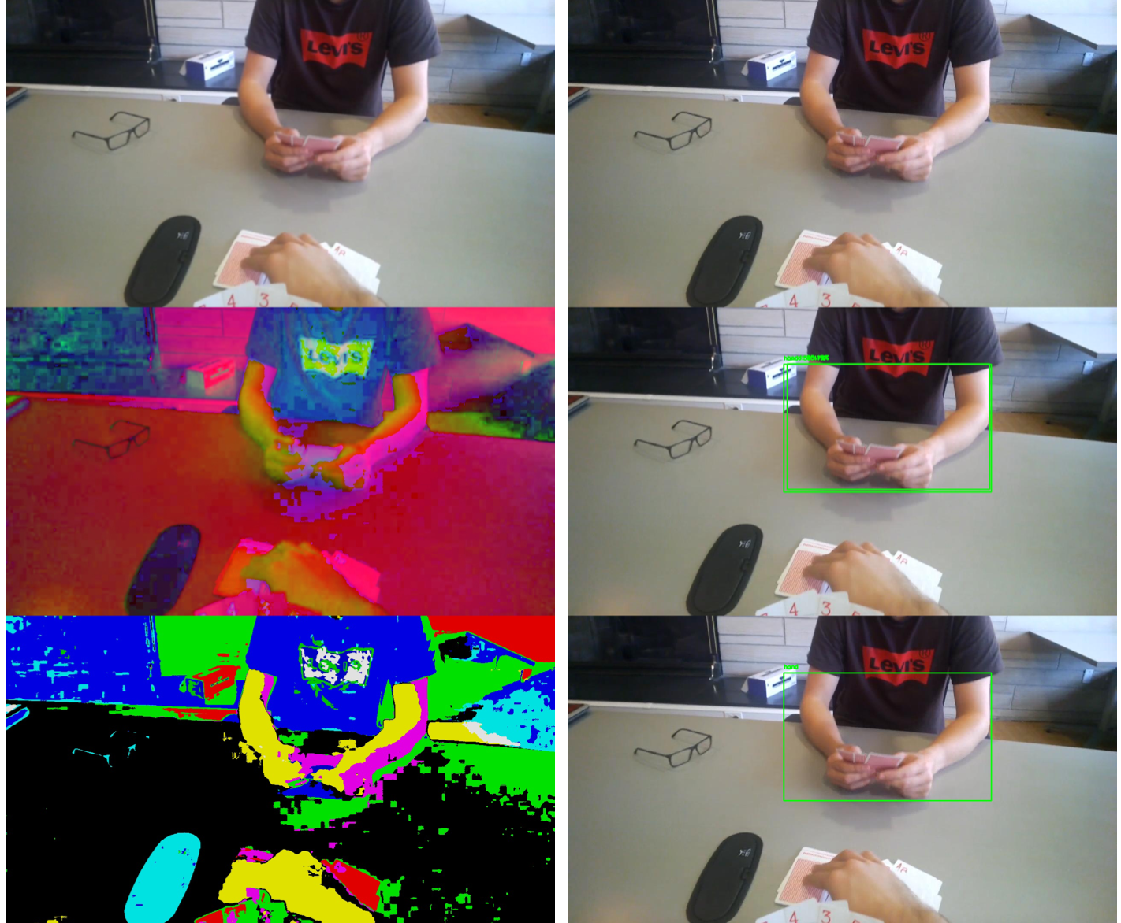
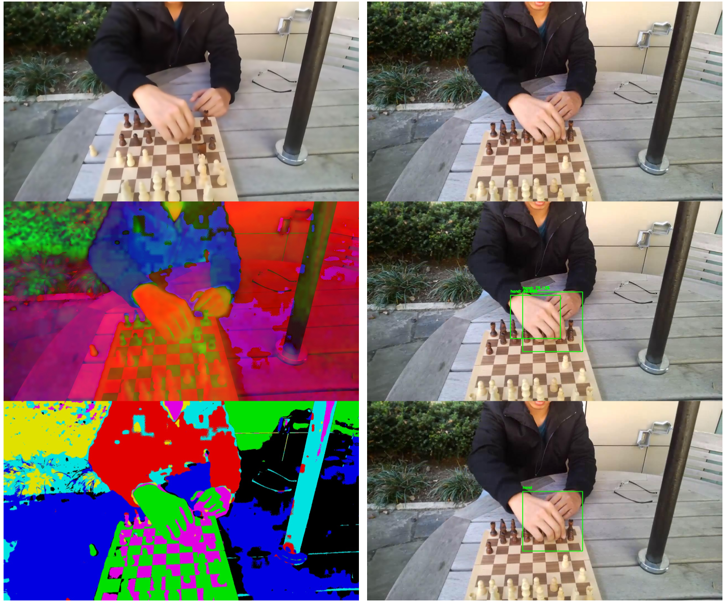

RESULTS
Demo: Images from a batch of test dataset to show the hand detection
Final result of R-CNN by mean shift segmentation for hand detection kernel size= 65
Final result of R-CNN by mean shift segmentation for hand detection
kernel size= 5

Slide 15
THANK YOU
QUESTIONS ARE WELCOME

